Slide 1
React: Building a Modern UI Experience at Appian
February 8th, 2017
Austin Fathman, Software Engineer
Kevin Hogan, Software Engineer II
Rose Wang, Software Engineer II
Notes:
Kevin 1-14
Austin 15-34
Rose 31-end
--Welcome people, thank them for coming, maybe engage the audience and ask a little about them and how they heard about Appian
--In today’s talk, we’re going to tell you about one of the most powerful features of our product, and how we leveraged React JS to bring it into the 21st century.

Slide 2
Agenda
Introductions
Why Appian?
Appian SAIL
React Lifecycle
Results
Q&A

Slide 3





Today, Every Company is Powered by Software
From a sneaker company to a data enabled athletic brand.
From a bookseller to insight driven delivery service, cloud servicer, and entertainment hub
From a car startup to Software, AI, and energy transformation.
From a transportation network to GPS and Autonomous cars
Notes:
--Think about how you might discuss the four companies on the left a couple decades ago
--You’d see a sports apparel company, a shipping company, a car manufacturer, and a taxi service
--Nowadays, you might say that all of these companies are software companies
--At the very least, you have to say software is at the core of each of these businesses
--The point to illustrate here is that the need for software is growing, but interest in becoming an engineer is remaining relatively flat.
--We can make up for this gap by making software development easier. Appian makes a certain type of software development a whole lot easier

Slide 4







PACKAGED
CUSTOM
Notes:
--Let’s focus on software intended to help businesses run better
--I’d split that software into two categories, software you get out of the box, and software you build from scratch

Slide 5
Why custom apps?
PACKAGED
CUSTOM
...because organizations and strategies are unique.
Notes:
So if packaged apps work right out of the box, why use custom software?
[Click for animation]
Because no two companies are the same, so no two companies are going to have the same needs and expectations for their applications. Packaged software can't anticipate and cover all needs of all companies, so there are going to be lots of things you can't do when using them. Custom software, however, is tailored specifically to your company's data and processes. You don't have to change anything about the way you work to use this software. Software should be a tool to help you do work, not something that forces you to work in a particular way.

Slide 6




BUT…
custom apps are difficult and expensive
Notes:
The downside is that custom apps are very difficult and expensive to build and maintain. They quickly become out of date, it's hard to build integrations between all your different applications, you have to build in all your own security frameworks, and so forth. And on top of that you have to hire people who are qualified to do this kind of work, which companies may not have.

Slide 7

: Application Platform
easy + powerful + unified
Notes:
--Appian steps in to solve this problem. We’ve built an abstraction for the process of deploying custom applications that is easy, powerful, and unified.
--Easy in that the implementation and maintenance of these applications is drastically simplified
--Powerful in that you still get to enjoy the flexibility of building an app that is truly custom.
--Unified in that you can build a variety of apps that interact with each other and share the same data

Slide 8

easy to use
Notes:
Appian provides one easy-to-use interface to access all of your different applications.
Our zero-training user interface makes it easy to:
find all the information you need
take any action you need
collaborate with any other user in order to get your work done efficiently and effectively.

Slide 9



easy to build
Notes:
Applications are easy to build using our low-code design environment.
Process flow is build using our drag-n-drop process designer.
Business logic is defined using our own functional expression language which is easy to learn.
Powerful, dynamic Interfaces are designed using a GUI.
This makes it easy to build complex applications quickly and in a cost-effective way.

Slide 10


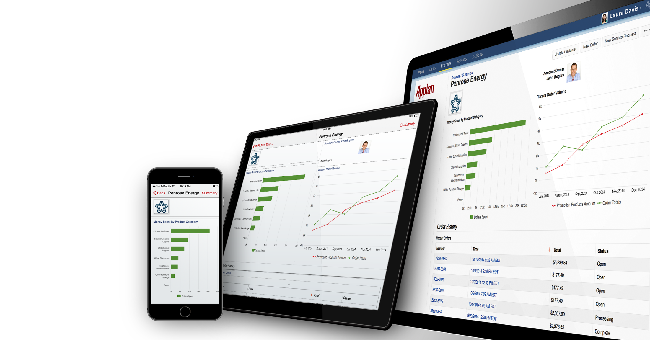
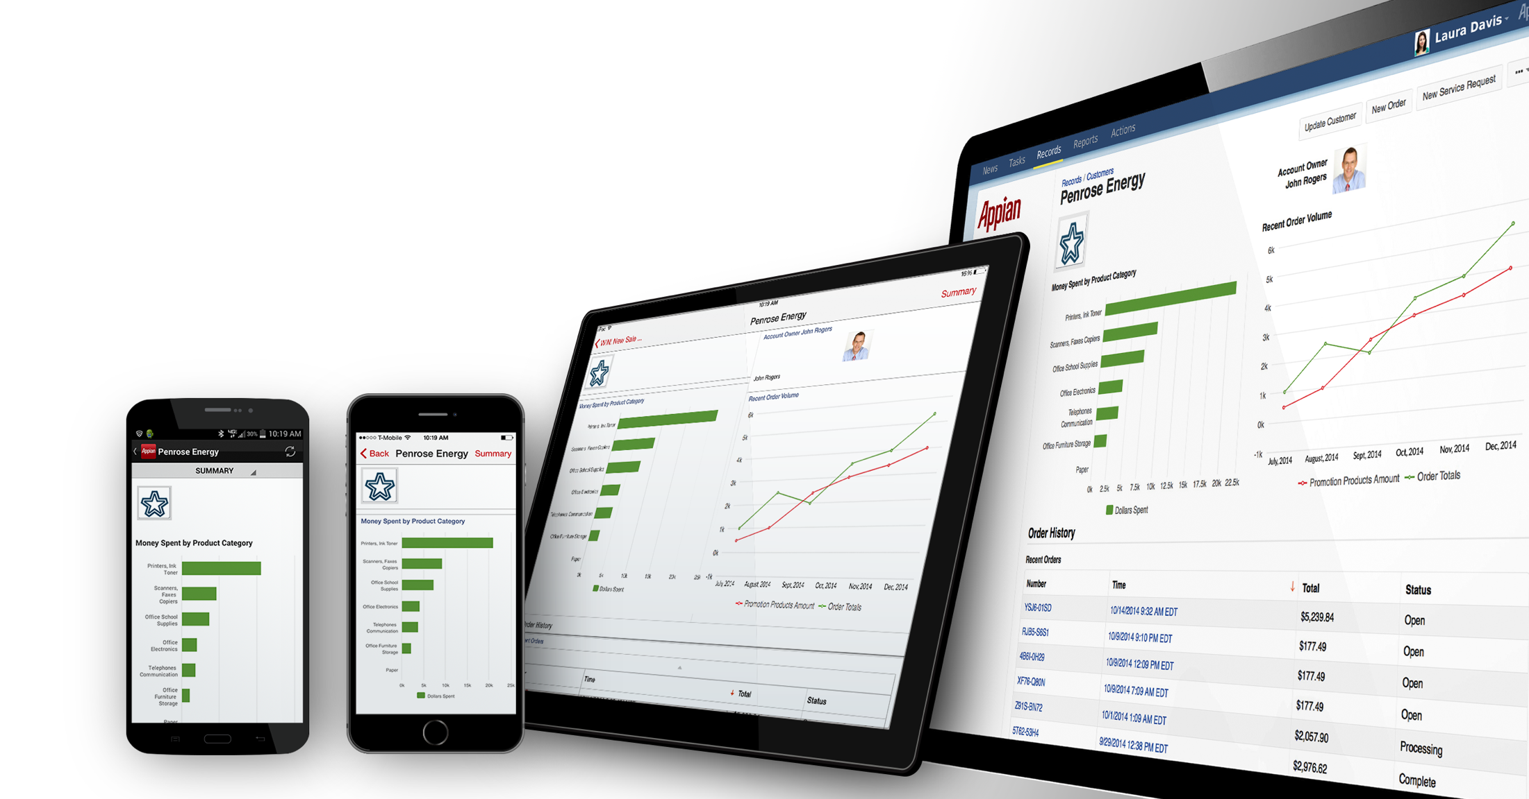
works on all devices
Notes:
Another thing that makes it easy to build is that you don't have to build specific applications for each device you want to use, it just works.
With Appian, you write or change something once, and then it just works everywhere.
You don’t have to test for every platform or any device.
You do things ONCE, and then everything just works on every device.
Appian is natively mobile…That’s important because:
apps work as expected by device
An iPhone app behaves like an iPhone app…Android like Android
Apps can take advantage of native device functionality
Camera, GPS, speech to text, etc.
You can do offline securely

Slide 11

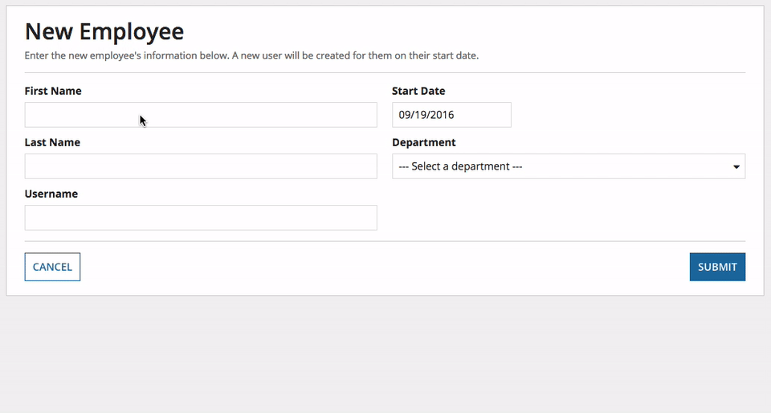
powerful and dynamic
Notes:
You might assume that since these applications are so easy to build and work on any device that this must mean that they're simple, but they're anything but. Appian enables our designers to build dynamic, interactive interfaces to bring their users the best possible experience. This means they can do stuff like dynamically pre-populating values, instant validations, and conditional display based on user interactions.
So how can our software let you build dynamic interfaces that work on any platform while still using native mobile applications?

Slide 12

Notes:
SAIL is
Patented Reactive UI framework
Uses our existing custom functional expression language.
Reactive means every change from the user, such as clicking, or entering text -- is treated as a state shift that produces an updated value, in our case a UI
(see also https://en.wikipedia.org/wiki/Reactive_programming)

Slide 13
SAIL: Simple, Declarative, Composable (Server)
A declarative UI framework built on top of Appian's built-in expression language, allowing designers to easily incorporate features of the Appian platform into complex interfaces.
Notes:
We won’t go into the expression language during this talk. When you’re looking at some of the coding examples for SAIL and you’re wondering what you would do to back a UI with real data, the expression language is what we use for that. It’s a mechanism for defining server-side logic to retrieve and manipulate data.
Declarative (as opposed to imperative): Writing code that says what you want rather than saying how you want to do it. We get to say “I want a text field here, and I want these things in it” as opposed to “Create box with solid border at these coordinates. Allow user to input text and keep track of the series of keystrokes while focused on that box...”. It’s really about a level of abstraction, and our language has a high level of abstraction. It’s declarative to the point of allowing us to declare a UI that can be interpreted separately on different clients
Composable: I’m trying to build a form. Well I’m going to make a textbox, and then as a sibling to that textbox, I want to have a new section. And inside of that section I want a few text boxes and then a picture. And now, I want to take this form I just built, and plug it in as a subset of another form. Well I’ll just expose this form as an interface rule and call it from the larger form. Composability is all about having the flexibility to put small things together in a variety of ways to build bigger, cooler things.

Slide 14
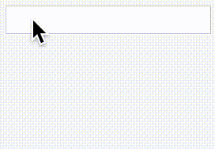
SAIL: Simple, Declarative, Composable (Server)
load(
value,
{
textField(
value: value,
saveInto: value,
refreshAfter: "keypress"
),
textField(
value: value,
readOnly: true
)
}
)
Notes:
The first thing you see in this declaration is a load function. This takes a list of variables to load into the context of execution (here we’ve declared one of them, named “value”). Value is used to populate the input of both text fields. The first text field is manipulating the “value” variable. We declare this through our saveInto property. The refreshAfter property allows us to specify how often we would like to do this save. You can imagine a case where you might not want to keep things so up to date. (Say you’re saving into a variable that is used to check if your phone number was properly formatted. It would be awfully annoying to be told every step of the way that your phone number didn’t match the appropriate pattern.) When our “value” variable updates, this is reflected in the second text field.
So this simple example is something that you could easily do in Javascript, but I just told you before that SAIL executes on the server. We’ll get into the client-server interactions of the SAIL framework in the coming slides. If you think of a more complicated form than this one, you can imagine the value of managing state changes through communicating with the server.

Slide 15


UI Frameworks: GWT (Google Web Toolkit) vs React
Problems with GWT
Slow Development Speed
Abstract from the UI
Difficult to customize
React Benefits
Modular Components
JS and JSX
Easy to apply styling (LESS)
Notes:
@Austin, start here
Talking points: a year ago, we were using GWT as our main front end implementation. Development was slow as it was difficult to test the component in isolation, and the complexity of our implementation was huge.
GWT is also in Java and is abstract from the UI, this doubled our work in designing the xml and implementing the java
GWT was also hard to customize as an imperative language
React fixed most of our issues:
React is modular, we can test and build a component in isolation
All the programming is done in JS and JSX (a way to express xml in javascript). We could essentially use the components our designers made for the frontend.
Easy to apply styling, since it is a declarative language, we had to focus less on how it worked and more so on being responsive and easily customizable.

Slide 16
React: Simple, Declarative, Composable (Client)
A component based, declarative UI library used to build interactive UIs for Web and Mobile Clients.

Slide 17
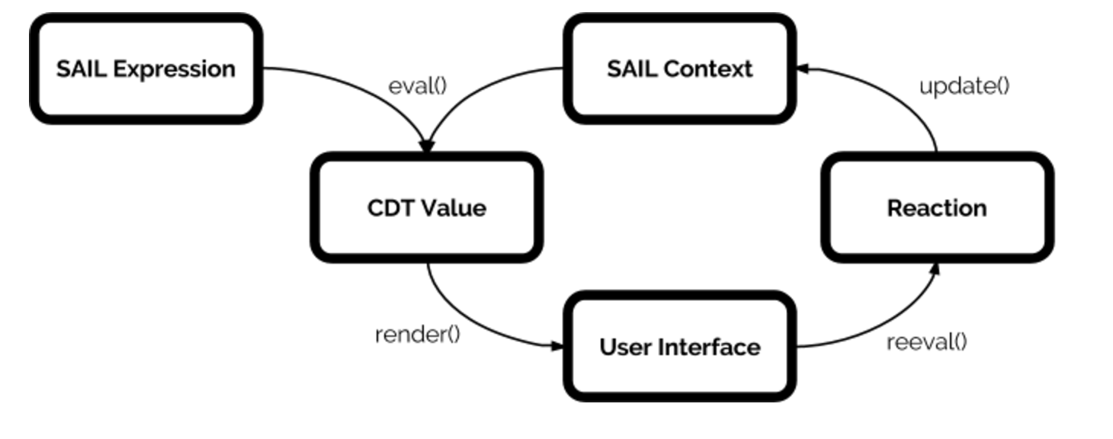
Notes:
delete?

Slide 18
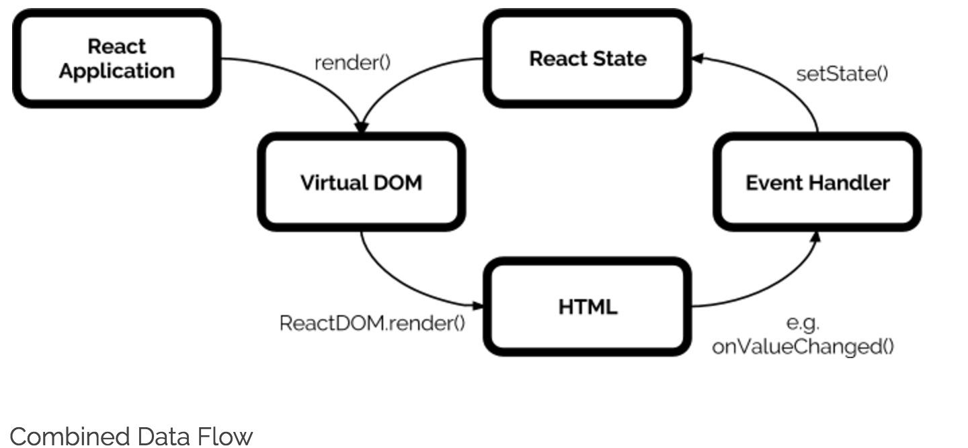
Notes:
delete?

Slide 19
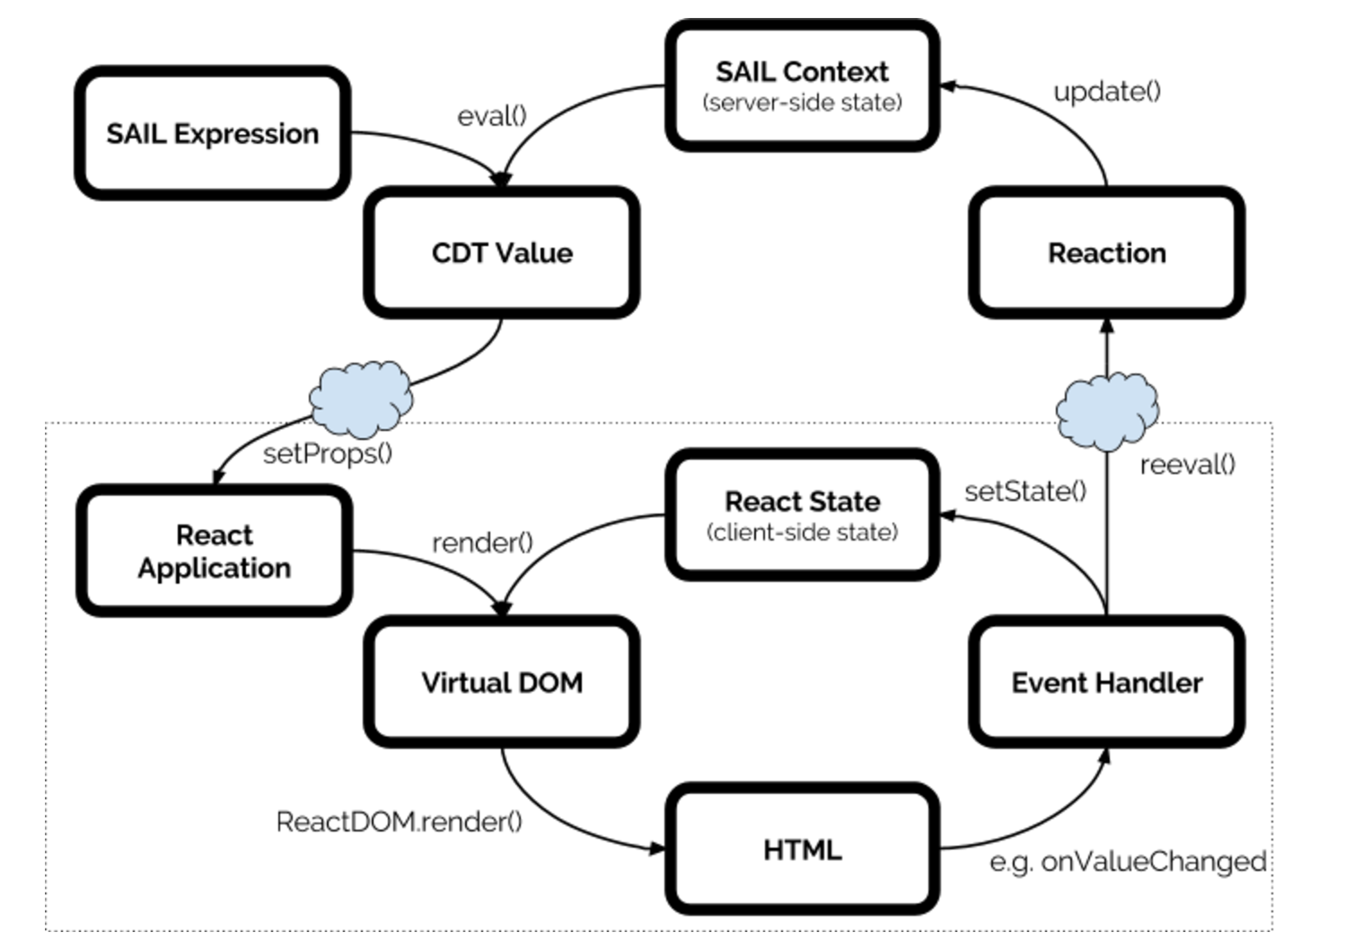
Notes:
delete?

Slide 20
React: Simple, Declarative, Composable (Client)
const TextField = React.createClass({
onInput(event) {
this.setState({
value: event.target.value
});
},
render() {
if (!readOnly) {
return (
<input onInput={this.onInput}
value={this.state.value} />
);
} else {
return (<p>{this.state.value}</p>);
}
}
});
Notes:
Here we have a boiled down React implementation to build the front end of the textfield we saw earlier. It’s not everything the sail does, as the SAIL expression also manages server side code, but we’ll get into that in a little bit.
React has a state component that you can set, and we have two render methods, one for if the textField is readOnly.

Slide 21

Mapping Sail to React
const TextField = React.createClass({
onInput(event) {
this.setState({
value: event.target.value
});
},
render() {
if (!readOnly) {
return (
<input onInput={this.onInput}
value={this.state.value} />
);
} else {
return (<p>{this.state.value}</p>);
}
}
});
load(
value,
{
textField(
value: value,
saveInto: value
),
textField(
value: value,
readOnly: true
)
}
)
Notes:
Here’s the sail code from earlier mapping to the react code. The textField in SAIL will map to our React TextField Component for web, and will render either the input box or <p> tag depending on the readOnly boolean.

Slide 22
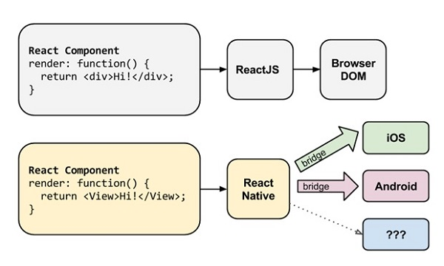
React: Simple, Declarative, Composable (Client)
TextField Component
render: function() {
return <input…. />;
}
TextField Component
render: function() {
return <TextInput… />;
}
Notes:
React comes in two flavors, ReactJS and React Native. ReactJS is used for web while react native is used in iOS and android. The ReactNative library comes with a ton of prebuilt bridged components. This saves us a lot of time, as historically, we’d have to map each SAIL component to Java code for Android and C# for iOS as well as the GWT for web.
Most of the JavaScript is shared between the ReactJS and React Native implementation, where only the render functions are different. Now we write the logic code once, make some render modifications for react native, and it deploys to all three platforms..

Slide 23
Appian SAIL: Functional Reactive Programming
first: "John",
last: "Smith",
with(
username: lower(concat(first, ".", last))
{
textField(label: "First", value: first, saveInto: first),
textField(label: "Last", value: last, saveInto: last),
textField(label: "Username", value: username, readOnly: true)
}
)
Notes:
Let’s look at a sample SAIL expression using our textFields to see how it all works. We’re going to build a user input form that takes the first name, last name, and generates a username based off of the full name.
Start with initialized varialbes

Slide 24
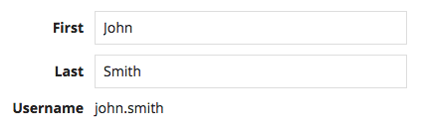
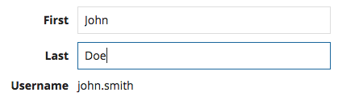
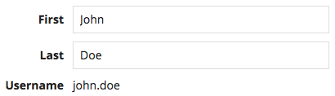
Appian SAIL: Functional Reactive Programming
first: "John",
last: "Smith",
username: "john.smith"
first: "John",
last: "Doe",
username: "john.smith"
first: "John",
last: "Doe",
username: "john.doe"
Notes:
Incremental updates - we enter "Doe" into the field for last. The change is made and the corresponding state is updated, so display now uses the new value
So this handles complex interplays of the UI

Slide 25
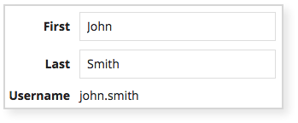






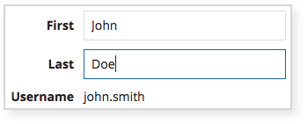
React Lifecycle
Client Renders UI
Evaluate Expression for Context & UI
User Interacts with UI
Original Context
first: "John"
last: "Smith"
username: "john.smith"
Update Context
last: "Doe"
Notes:
Lifecycle
So how does this update process work in react?
Incremental updates - we enter "Doe" into the field for last. The change is made and the corresponding state is updated, so display now uses the new value
So this handles complex interplays of the UI

Slide 26
React Lifecycle: Evaluate Expression
Evaluate Expression for Context & UI
Original Context
first: "John"
last: "Smith"
username: "john.smith"
Notes:
We Start with the original state we entered in from the expression with John Smith

Slide 27

React Lifecycle: Evaluate Expression
first: "John",
last: "Smith",
with(
username: lower(concat(first, ".", last))
{
textField(
label: "First",
value: first,
saveInto: first
),
textField(
label: "Last",
value: last,
saveInto: last
),
...
}
)
{
{
type: "TextField",
value: {
label: "First",
value: "John",
saveInto: first
}
},
{
type: "TextField",
value: {
label: "Last",
value: "Smith",
saveInto: last
}
...
Notes:
When the page is initially requested, this sail is sent from the server to the client as JSON, with the type information, initial value and saveInto

Slide 28
React Lifecycle: Client Render UI
Client Renders UI
Evaluate Expression for Context & UI
Original Context
first: "John"
last: "Smith"
username: "john.smith"
Notes:
The Client, whether it be mobile or web, receives the JSON and renders the UI.

Slide 29
React Lifecycle: Client Render UI
const TextField = React.createComponent({
onBlur() {
...
},
render() {
const { model } = this.props;
const value = model.get('value');
if (model.get('readOnly')) {
return <p>{value}</p>;
}
return (<input
value={value}
onBlur={this.onBlur} />
);
}
});
{
type: "TextField",
value: {
label: "First",
value: "John",
saveInto: first
}
}
Notes:
The client takes the JSON and maps it to the relevant code. In this case, a web client is mapping the JSON to the TextField react component we created earlier. Note, we have added an onBlur method here in which will call a re-evaluation.

Slide 30
React Lifecycle: User Interacts with UI
Client Renders UI
Evaluate Expression for Context & UI
User Interacts with UI
Original Context
first: "John"
last: "Smith"
username: "john.smith"
Notes:
Now the user is interacting with our textfield

Slide 31
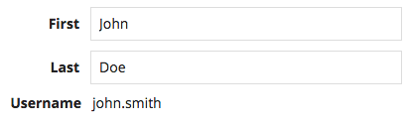
React Lifecycle: User Interacts with UI
const TextField = React.createComponent({
onBlur(event) {
sendReevaluationRequest({
value: event.target.value
});
},
render() {
...
}
});
Notes:
The user enters in Doe and clicking away. We then call the onblur on the textField of Last.

Slide 32
React Lifecycle: Update Context
Client Renders UI
Evaluate Expression for Context & UI
User Interacts with UI
Original Context
first: "John"
last: "Smith"
username: "john.smith"
Update Context
last: "Doe"
Notes:
Which leads us to updating the context.
Remember, because we’ve set up the expression to dynamically compose the username of the individual, there are some logic that needs to go into updating the UI.

Slide 33
React Lifecycle: Update Context
first: "John",
last: "Smith",
with(
display: lower(concat(first, ".", last))
{
textField(
label: "First",
value: first,
saveInto: first
),
textField(
label: "Last",
value: last,
saveInto: last
),
...
}
)
const TextField = React.createComponent({
onBlur(event) {
sendReevaluationRequest({
value: event.target.value
});
},
render() {
...
}
});
Notes:
After the user interacts with the client, the client talks back to the server with the SAIL expression to update the context. We send a reevaluation request to the server when the user blurs away from the component, and as you can see in our expression, it then gets saved into the local variable “last” in our SAIL layer.

Slide 34
React Lifecycle: Update Context
first: "John",
last: "Doe",
with(
username: lower(concat(first, ".", last))
{
…,
textField(
label: "Last",
value: last,
saveInto: last
),
textField(
label: "Username",
value: username,
readOnly: true
),
}
)
{
...
{
type: "TextField",
value: {
label: "Last",
value: "Doe",
saveInto: last
}
},
{
type: "TextField",
value: {
label: "Username",
value: "john.doe",
readOnly: true
}
}
}
Notes:
Once local variable “last” is updated from “Smith” to “Doe”, we evaluate the rest of the expression to compose the username using the updated “last” local variable. Mapping that to JSON, both the text fields for the last name and the username gets updated

Slide 35
React Lifecycle: Re-Render the Client
Client Renders UI
Evaluate Expression for Context & UI
User Interacts with UI
Original Context
first: "John"
last: "Smith"
username: "john.smith"
Update Context
last: "Doe"
Notes:
After we evaluate the expression and send back to the client the updated UI, we go back to the beginning of the cycle and re-render the UI

Slide 36
React Lifecycle: Re-Render the Client ->Before
{
...
{
type: "TextField",
value: {
label: "Last",
value: "Smith",
saveInto: last
},
{
type: "TextField",
value: {
label: "Username",
value: "john.smith",
readOnly: true
}
}
}
<input value="John">
<input value="Smith">
<p value="john.smith">
Notes:
Before the change, the elements on the right show the DOM structure, along with the values of the elements that the JSON maps to. We have an input element for the first name, last name, and because the the text field for username is read-only, that text field maps to a p-tag element.

Slide 37
React Lifecycle: Re-Render the Client ->Before
{
...
{
type: "TextField",
value: {
label: "Last",
value: "Smith",
saveInto: last
},
{
type: "TextField",
value: {
label: "Username",
value: "john.smith",
readOnly: true
}
}
}
<input value="John">
<input value="Doe">
<p value="john.smith">
Notes:
After the user changes the value of last name input element, that input element’s value is updated on the client with the new last name, and we send back the new value to the server and evaluate the UI expression, as I have already discussed

Slide 38
React Lifecycle: Re-Render the Client ->After
{
...
{
type: "TextField",
value: {
label: "Last",
value: "Doe",
saveInto: last
},
{
type: "TextField",
value: {
label: "Username",
value: "john.doe",
readOnly: true
}
}
}
<input value="John">
<input value="Doe">
- <p value="john.smith">
Notes:
After the UI evaluates and the updated JSON gets sent down, we find the updated component and re-render that component. And here is really where the beauty of React kicks in. Because React’s setup allows for partial evaluation, we don’t have to re-render the entire UI for an update to one of the components, and this allows for faster rendering and more efficient usage of our CPU. Even though we are sending back two changes - one for the Last name text field and one for the username, the last name input box already has the updated value because the user updated it. So in this case, we detect the update to the value of that readOnly username text field...

Slide 39
React Lifecycle: Re-Render the Client ->After
{
...
{
type: "TextField",
value: {
label: "Last",
value: "Doe",
saveInto: last
},
{
type: "TextField",
value: {
label: "Username",
value: "john.doe",
readOnly: true
}
}
}
<input value="John">
<input value="Doe">
+ <p value="john.doe">
Notes:
...and we re-render just that p tag with the new value.

Slide 40
Client Renders UI
Evaluate Expression for Context & UI
User Interacts with UI
Original Context
first: "John"
last: "Smith"
username: "john.smith"
Update Context
last: "Doe"
Notes:
And there you have it! The complete lifecycle of a UI with React!

Slide 41
Results?
Notes:
So now that we’ve talked about how the React library fits in with the rest of our software framework, let’s talk about the results.

Slide 42
Results?
Overhaul of 50+ component UIs in one year
Notes:
As a result of our Modern UI program, we’ve been able to overhaul over 50 components UI in one year. The program grew from 4 developers to over 75 with very little barrier to entry. Our developers were able to learn the language and technology quickly, and development turnaround was much faster than our previous development with GWT.

Slide 43
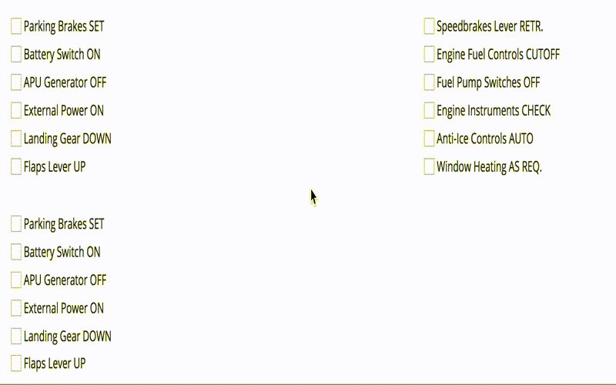
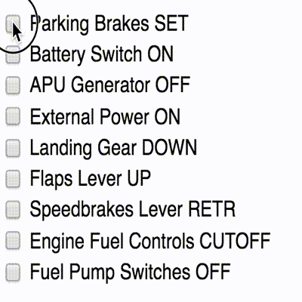
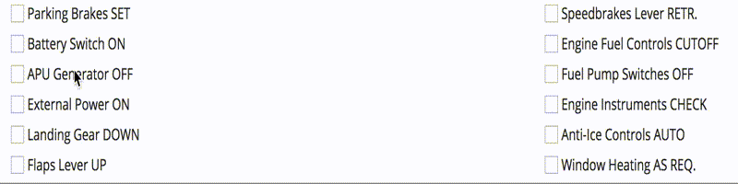
Results?
Overhaul of 50+ component UIs in one year
Notes:
Before:
Square photos for users
Dropdown was not the same width as the input box
After:
Switched to circular avatars
Dropdown is same width as the input box
Options are larger, allowing for scrolling

Slide 44
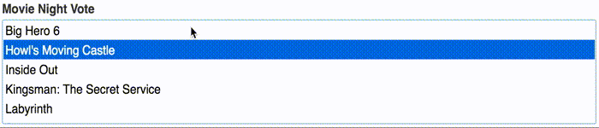
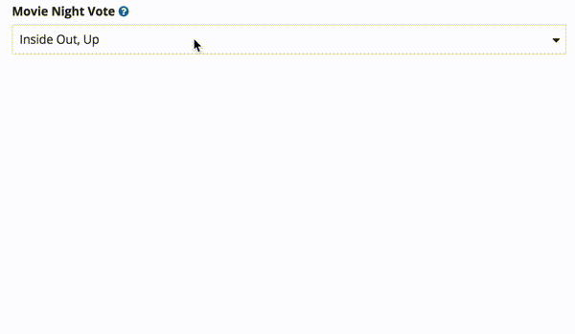
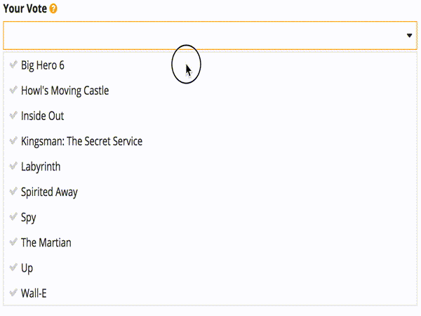
Results?
Overhaul of 50+ component UIs in one year
Notes:
Before:
Not really a dropdown, just a list
After:
Allows for color accents, which means more customization
We’ve added a cool icon to indicate selection
An actual dropdown

Slide 45

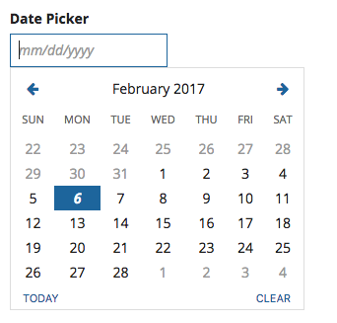
Results?
Overhaul of 50+ component UIs in one year
Notes:
After:
Sleeker design, allows for accent color configuration
“Today” and “Clear” quick links

Slide 46


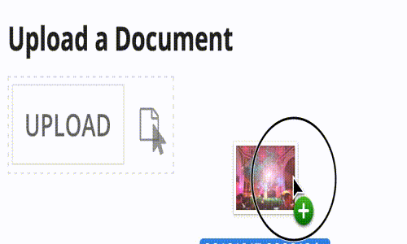

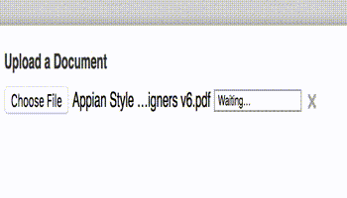
Results?
Overhaul of 50+ components’ UI in one year
Notes:
Before (prior to upload):
Drab-looking button
After (prior to upload):
Beautiful button with font-awesome icon
Before (while loading):
Progress bar
Misleading button that you are not going to be able to click
If long file name, it will truncate the middle and show you the beginning and end
After (while loading):
Simple, intuitive progress circle
Showing much more information, including the entire filename and file extension, along with file size
In addition, we were also able to easily implement a drag and drop behavior, so users no longer have to navigate through the file directory on the browser

Slide 47
Results?
Overhaul of 50+ components UI in one year
Ability to support highly-customized UIs

Slide 48
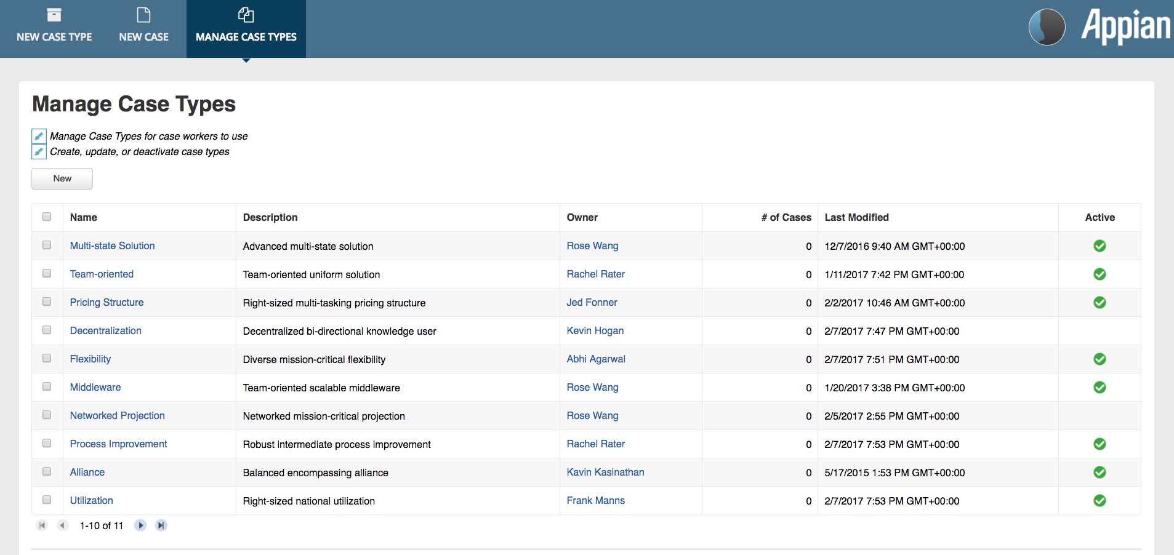
Results?

Slide 49
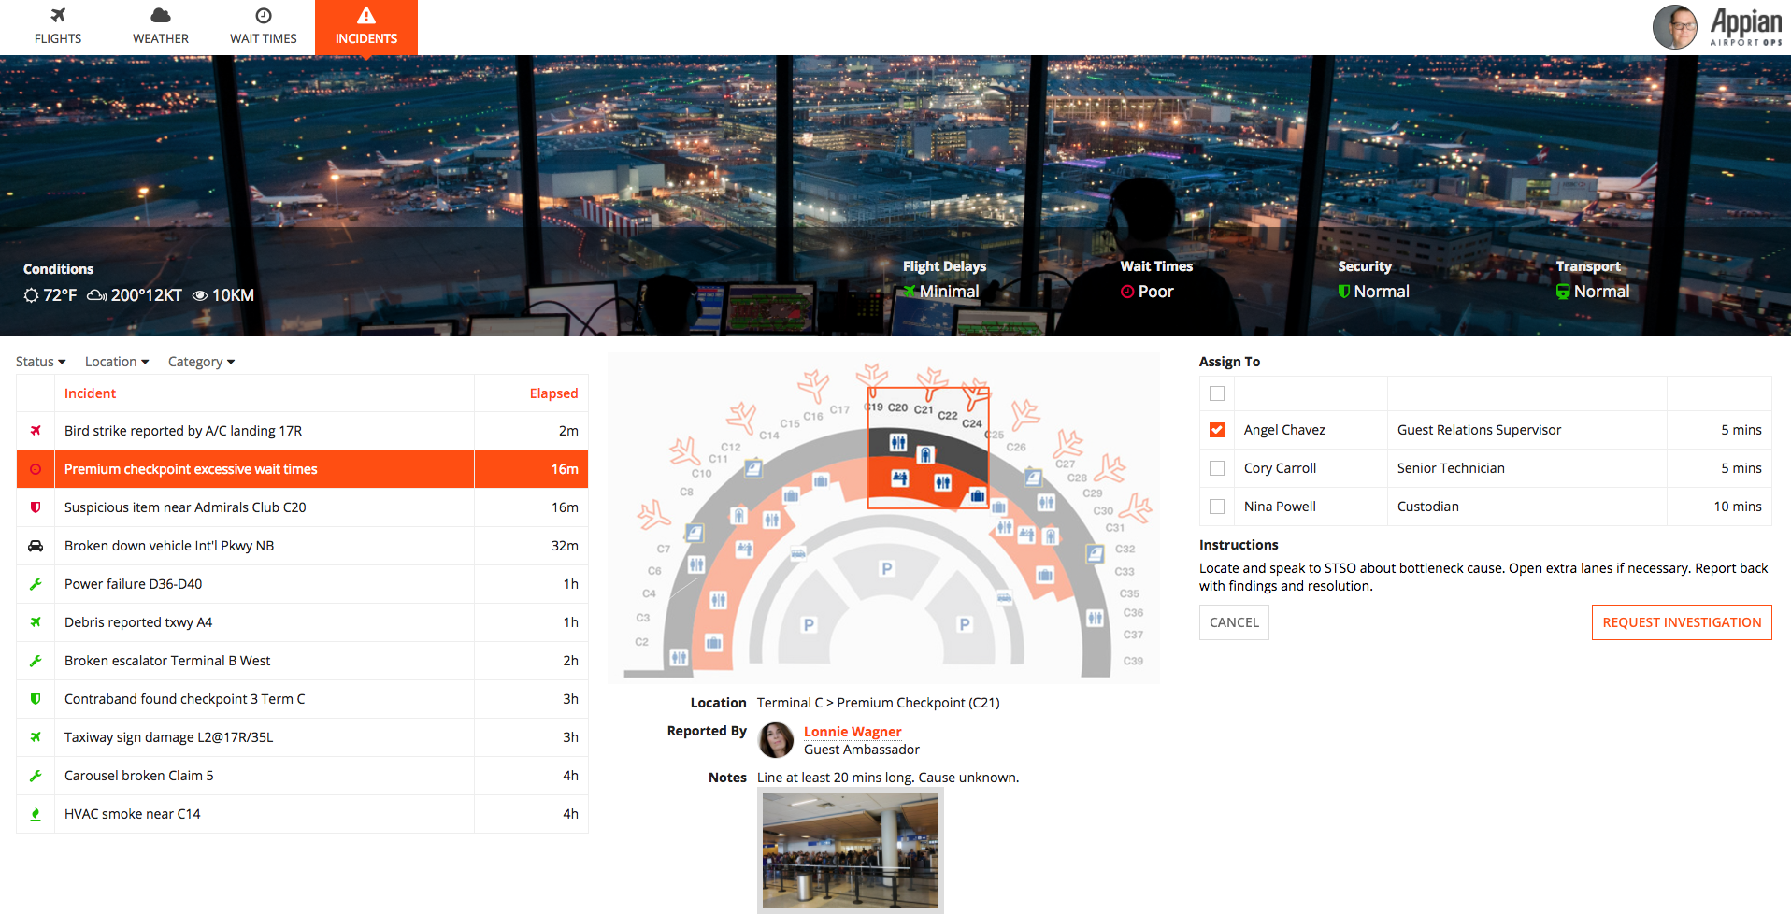
Results?

Slide 50

Results?

Slide 51



Results?
Overhaul of 50+ components UI in one year
Ability to support highly-customized UIs
Minimal rework on iOS and Android thanks to React Native

Slide 52



Slide 53
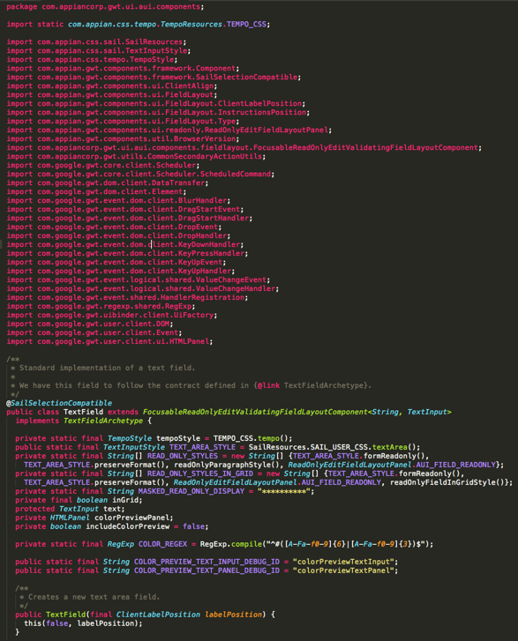
Legacy GWT Implementation
Notes:
@Austin, start here
Talking points: About a year ago, we used GWT as our main front end implementation. Development was slow as it was difficult to test the component in isolation, and the complexity of our implementation was huge. Here is our full implementation of a TextField in GWT.
Use TextField in hook
Everyone can use Java! Yay!
REDO: GWT vs React
JAVA vs JS
Speed
Abstraction from UI -> closely tied
Modern UI -> more customizable
Development velocity

Slide 54
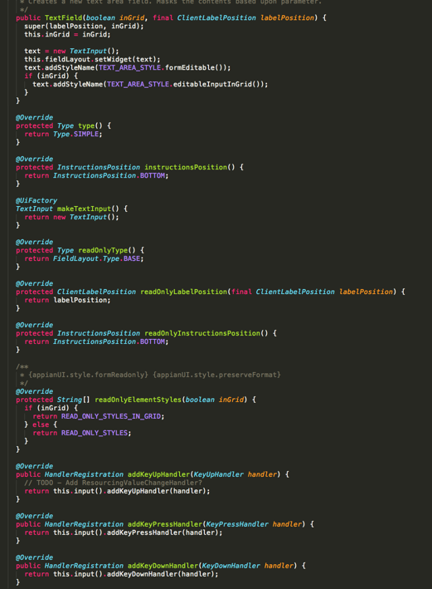
Legacy GWT Implementation
Notes:
Lots of imports

Slide 55
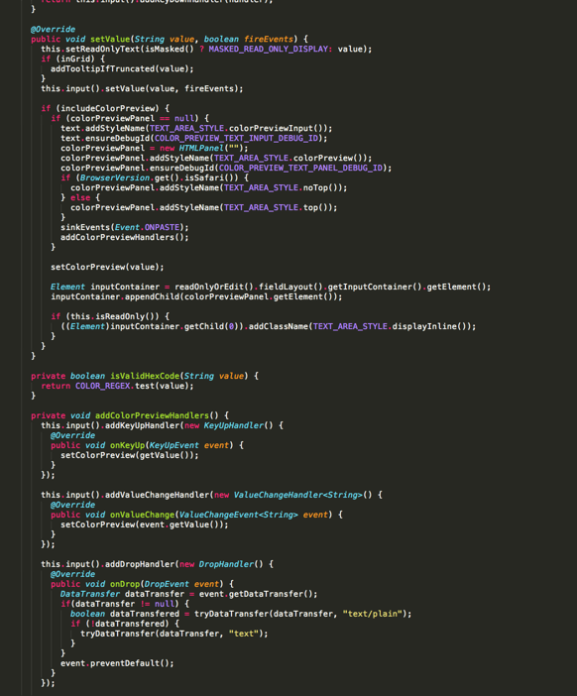
Legacy GWT Implementation
Notes:
And a ton keyhandlers and state managers.
Part of being a software company is the learning to grow and adapt to customer needs. And our customers wanted more customizable UIs. However, with the GWT implementation, it was difficult to apply styling and expand the functionality without a complete re-write of our GWT code. The way we have implemented GWT didn’t not tie in with our SAIL framework lifecycle, so we looked into other options.

